Slide 1


Introduction to
Robotic Process Automation
PRODUCT
AVAILABILITY
CHECKER
Register no:220701028
Name: ARTHEY C
Guide Name: Mrs. J. Jinu Sophia
Designation: Assistant Professor(SG)
Department:Computer Science & Engineering

Slide 2
Abstract
The Product Availability Checker is an automated solution built using UiPath Studio to monitor the stock status of products on Amazon. The bot reads a list of product names and URLs from an Excel file and systematically checks their availability on the platform. If a product is in stock, the bot instantly notifies the user via email with the product details. For unavailable items, the bot enters a continuous loop, rechecking their status every 30 minutes until they are back in stock, at which point the user is promptly informed. This project streamlines the tedious task of manual product monitoring, ensuring timely updates and enhancing user convenience.

Slide 3
Need for the Proposed System
Manually tracking the availability of products on e-commerce platforms like Amazon can be time-consuming and inefficient, especially for high-demand items. Users often miss restocking updates due to the fast-paced nature of online sales.
The Product Availability Checker automates this process, eliminating the need for constant manual checks. By continuously monitoring stock status and sending instant email notifications when products are available, the system ensures users receive timely updates, saving time and enabling prompt purchasing decisions.

Slide 4
Advantages of the Proposed System
Automation of Stock Monitoring: The system automatically tracks product availability, saving time and effort for users.
Timely Notifications: Instant email alerts ensure users are informed as soon as a product is back in stock.
Reduced Manual Effort: Users no longer need to repeatedly check e-commerce websites, simplifying the shopping process.
24/7 Monitoring: The system continuously operates, providing updates even when the user is unavailable.

Slide 5
Literature Survey
Paper 1:
Masri, Amirah Shaali. "Augmented Reality Based Product Availability Checker Using Junaio Browser." (2011).
Advantages:
Enhanced User Experience:
  Provides real-time, interactive information to help users quickly identify nearby shops and available products using AR technology.
Convenience:
  Bypasses traditional search methods, offering a faster and easier way to check product availability in surrounding stores.
Disadvantages:
Limited Coverage:
  The system is restricted to specific locations, limiting its usefulness to users within certain buildings or areas.
Device Dependency:
  2. Relies on smartphones with AR capabilities, excluding users without access to such devices.

Slide 6
Literature Survey
Paper 1:
Selecting the appropriate product monitoring levels for maintenance operations: A simulation approach
Advantages:
Improved Product Monitoring:
  Discrete Event Simulation (DES) helps evaluate various monitoring levels, enabling better decision-making to improve product availability and maintenance efficiency.
Data-Driven Insights:
  The use of diagnostics and prognostics allows for predicting potential failures, leading to proactive maintenance and potentially reducing downtime.
Disadvantages:
Complexity in Implementation:
  Applying advanced monitoring techniques and simulations might require significant expertise and resources, increasing the complexity of the system setup.
Potential Overhead:
  High levels of monitoring could lead to additional operational costs or resource usage, which may not always justify the improvements in availability, especially in smaller-scale applications.

Slide 7
Main Objective
The main objective of the Product Availability Checker is to automate the process of monitoring product stock status on e-commerce platforms, such as Amazon, and provide real-time notifications to users. By leveraging UiPath Studio for automation, the system aims to eliminate the need for manual checks, ensuring users are promptly informed via email when desired products become available. This enhances user convenience, saves time, and ensures they never miss out on purchasing opportunities for high-demand items.

Slide 8
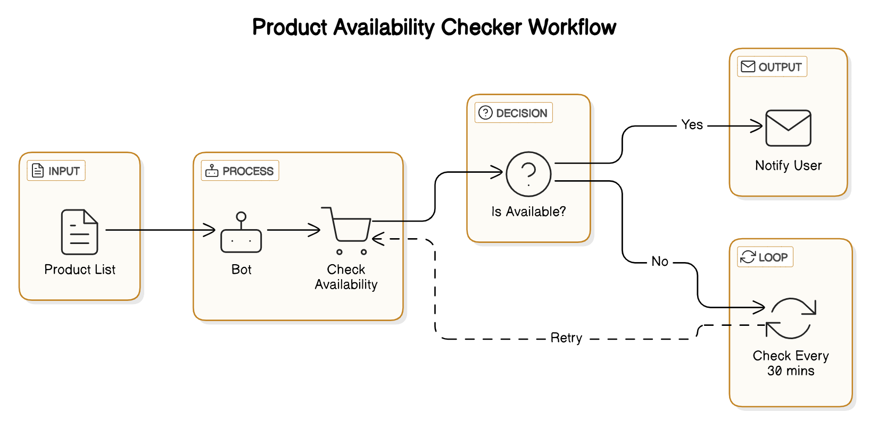
Architecture

Slide 9
System Requirements
HARDWARE REQUIREMENTS
UiPath Studio: Latest version
Operating System: Windows 10 (64-bit) or later
Microsoft Excel: 2016 or later
Email Service: SMTP (Gmail, Outlook)
SOFTWARE REQUIREMENTS
Web Browser: Chrome, Firefox, Edge
Processor: Intel i5 or higher
Storage: 10 GB free space
Network: Stable internet
Display: 1366x768 resolution

Slide 10
Functional Description
Module 1:Product Availability Checking
Description: This module automates checking the availability of products listed in an Excel file. The bot reads product names and URLs from the file and periodically checks if each product is available for purchase on Amazon, either by scraping the page or using an API (if available). The bot checks every 30 minutes and stops once the product is in stock. Once available, the bot sends an email notification to the user, ensuring timely alerts without manual intervention.

Slide 11
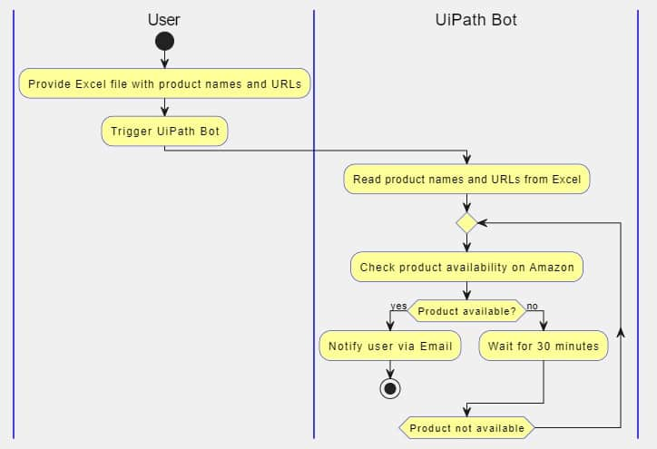
Activity Diagram

Slide 12
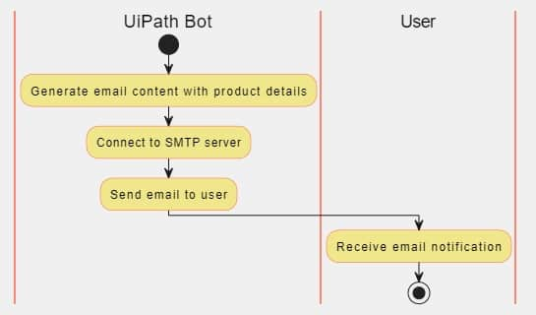
Module 2: Email Notification
Description: This module is responsible for sending email notifications to the user when a product becomes available for purchase. It uses an SMTP service to send the email and provides the product's availability status.

Slide 13
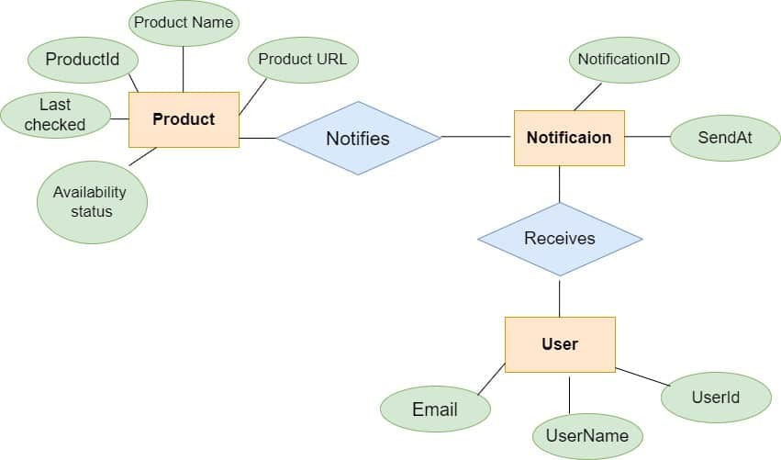
Entity Relationship Diagram
ERD

Slide 14
PROCESS DESIGN
MAIN PROCESS
The main process orchestrates the complete workflow of the product availability checker system, ensuring seamless operation and automation. It starts by extracting product data, including names and URLs, from an Excel file provided by the user. This data is then processed to initiate periodic checks for product availability on Amazon. The system uses web scraping to verify the stock status of each product. If any product is detected as available, the main process immediately triggers the notification mechanism to alert the user via email. The process continues to monitor and recheck the availability of unavailable products at regular intervals, maintaining a cycle of checks until all desired products are in stock. This design ensures consistent tracking without manual intervention, saving time and effort for the user.

Slide 15
PROCESS DESIGN
SUB PROCESS
Data Extraction: Reads product names and URLs from the Excel file and validates the input data.
Product Availability Check: Periodically checks the availability of each product on Amazon using web scraping or an API.
Notification Handling: Sends email notifications to users when the product status changes to available.
Recheck Scheduler: Waits for a predefined interval (e.g., 30 minutes) before initiating another availability check for unavailable products.

Slide 16
Implementation
Module 1: Product Availability Checking
This module automates the process of checking product availability on Amazon. It begins by reading product data, including names and URLs, from an Excel file provided by the user. The bot then uses web scraping techniques to access each product's page and determine its stock status. The bot handles periodic checks, waiting 30 minutes between each cycle to avoid unnecessary requests and ensure up-to-date results. The workflow is designed to continue monitoring until the product becomes available, at which point the module passes the data to the notification system. This module ensures accurate tracking of product availability without requiring user intervention.

Slide 17
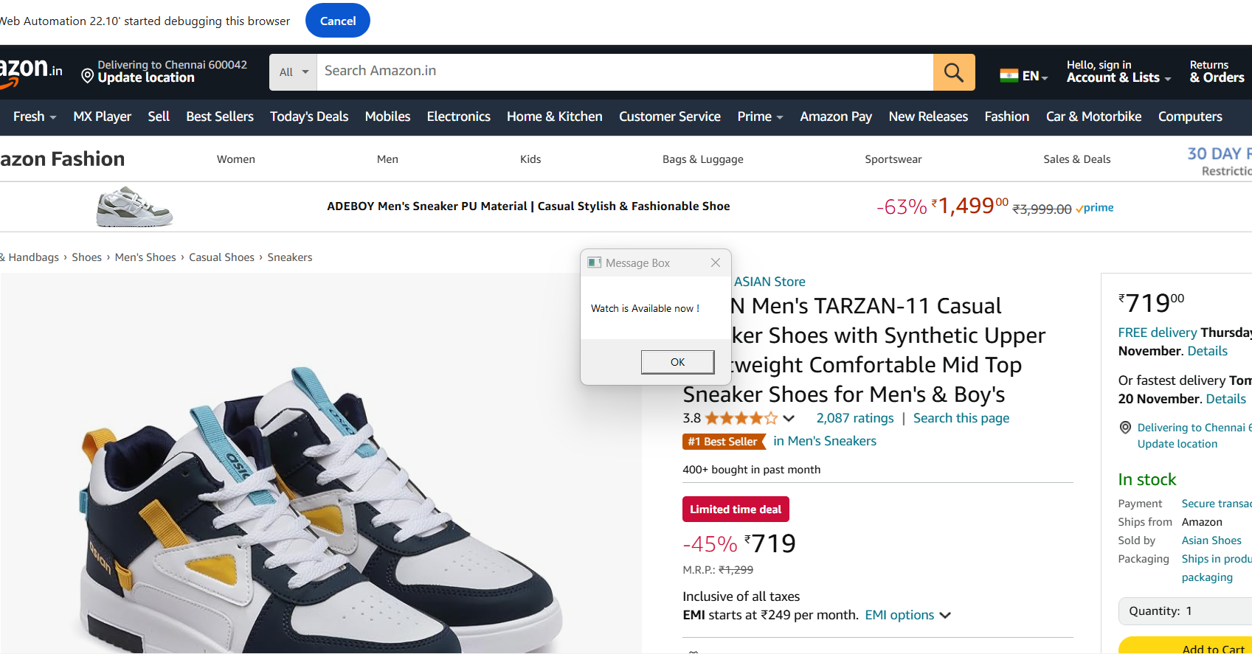
Implementation

Slide 18
Implementation
Module 2: Notification Handling
The notification handling module is responsible for promptly informing the user when a product becomes available. Upon detecting a product in stock, the bot triggers this module to compose and send an email to the user. The email includes details such as the product name, URL, and current availability status. The module uses SMTP or a similar email service to send notifications efficiently. Additionally, it logs the notification details for future reference. This module ensures timely alerts, enabling the user to take immediate action to purchase the product.

Slide 19
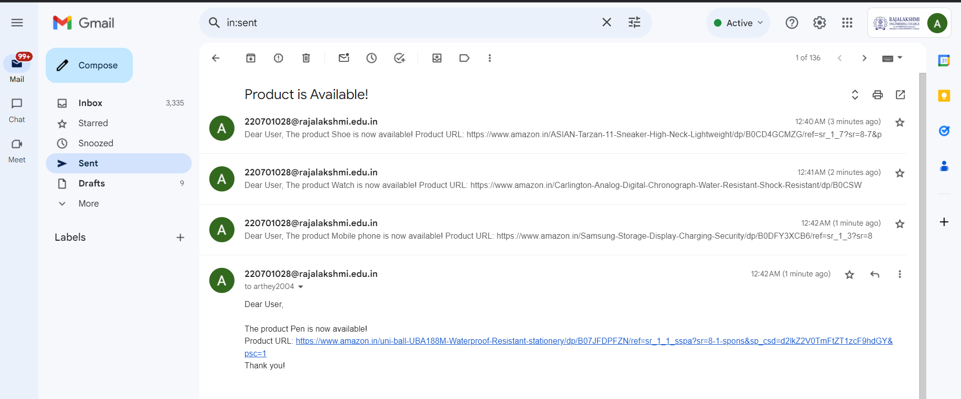
Implementation

Slide 20
Testing
Test Description: Verifying the functionality of the Product Availability Checker in checking stock availability and sending notifications.
Input: A list of product names and URLs from an Excel file, including both in-stock and out-of-stock items.
Expected Output:
  For in-stock items, an email notification is sent to the user with product details.
  For out-of-stock items, the system rechecks every 30 minutes until the product becomes available, at which point a notification is sent to the user.
Actual Output:
  Emails are successfully sent when a product is in stock, and the notification includes correct product details.
  For out-of-stock items, the system enters a loop and continues to recheck the product availability every 30 minutes until it becomes available, then sends an email notification.

Slide 21
Conclusions
The Product Availability Checker project successfully automates the process of monitoring product stock status on Amazon. By integrating web scraping techniques with periodic checks, the bot efficiently reads product data from an Excel file, continuously tracks availability, and notifies the user via email once the product becomes available. The implementation includes error handling through a Try-Catch block, ensuring smooth operation even in the case of connectivity issues. The system has been thoroughly tested for both individual components and overall functionality, ensuring reliable performance. This project not only saves users time by automating manual checks but also provides a user-friendly solution that guarantees timely notifications.

Slide 22
Future Enhancement
Multi-Platform Support: Extending the bot's capability to check product availability on multiple e-commerce platforms beyond Amazon, such as eBay or Walmart, to offer a more comprehensive product tracking system.
Price Tracking: Adding functionality to monitor price fluctuations along with stock availability, alerting users when the product price drops below a certain threshold.

Slide 23
IEEE Paper
Paper 1:
Title: Selecting the appropriate product monitoring levels for maintenance operations: A simulation approach
Authors: Abdullah A. Alabdulkarim; Peter D. Ball
https://ieeexplore.ieee.org/stamp/stamp.jsp?tp=&arnumber=10200497&isnumber=10199188
Paper 2:
Title: Product similarity detection in E-Commerce website
Authors: Gayathri R S; Kanagaraj S
https://ieeexplore.ieee.org/stamp/stamp.jsp?tp=&arnumber=7019962&isnumber=7019868

Slide 24
References
S. Gupta, P. Sharma, and R. Mehra, "A product availability monitoring system using web scraping techniques," Journal of Web Automation and Scraping, vol. 12, no. 3, pp. 45-58, 2020.
M. Ahmed and J. Lee, "Designing automated product trackers with email notification systems," International Journal of E-commerce and Technology, vol. 34, no. 2, pp. 123-134, 2021.
R. Singh and P. Patel, "An overview of web scraping for real-time e-commerce product monitoring," Journal of Internet Technology, vol. 50, no. 4, pp. 789-801, 2022.

Slide 25
Queries

Slide 26
Demonstration

Slide 27
Thank You

